Slide 1

Building & Mining Knowledge Graphs
(KEN4256)
Lecture: ELSI of Knowledge Graphs
Marcel Schaper
(Faculty of Law)

Slide 2
Lecture outline
What are ELSI?
Brainstorm: ELSI in data science
Examples of ELSI
Applications to your individual projects

Slide 3

What are ELSI ?
Ethical Is it right or wrong?
Legal Does the law allow it?
Social Is it controversial in view of social norms or beliefs? Does it influence a considerable number of persons?
Issues (Implications or Aspects - ELSA)
James Watson
(Human Genome Project)
Source: Wikipedia
Notes:
E drives L (formal E) and S (the social collective)

Slide 4
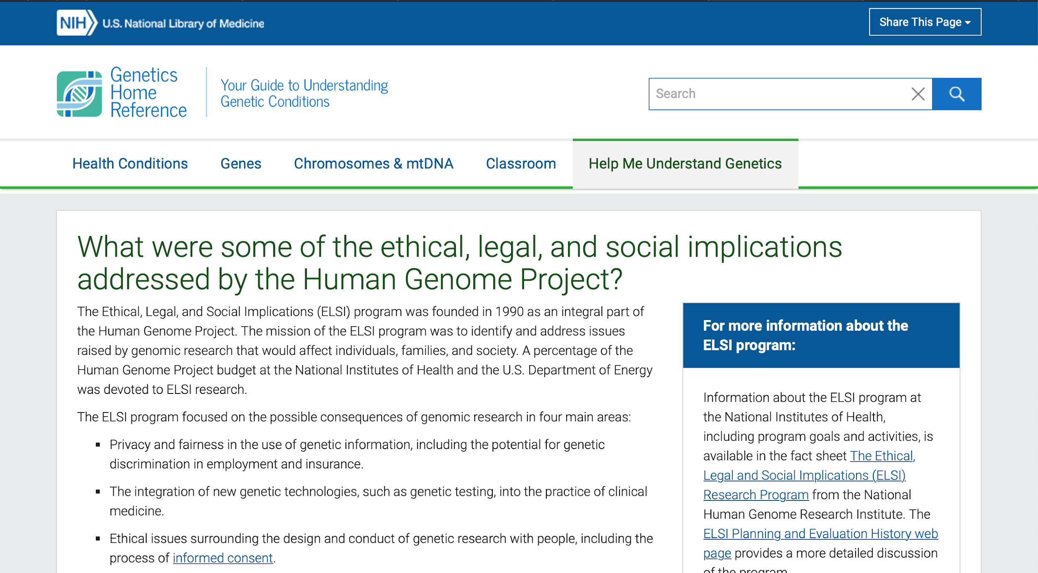

Slide 5
What are ELSI ?
Ethical According to what moral norms?
Legal Which law?
Social Where?
Issues
Notes:
E drives L (formal E) and S (the social collective)

Slide 6
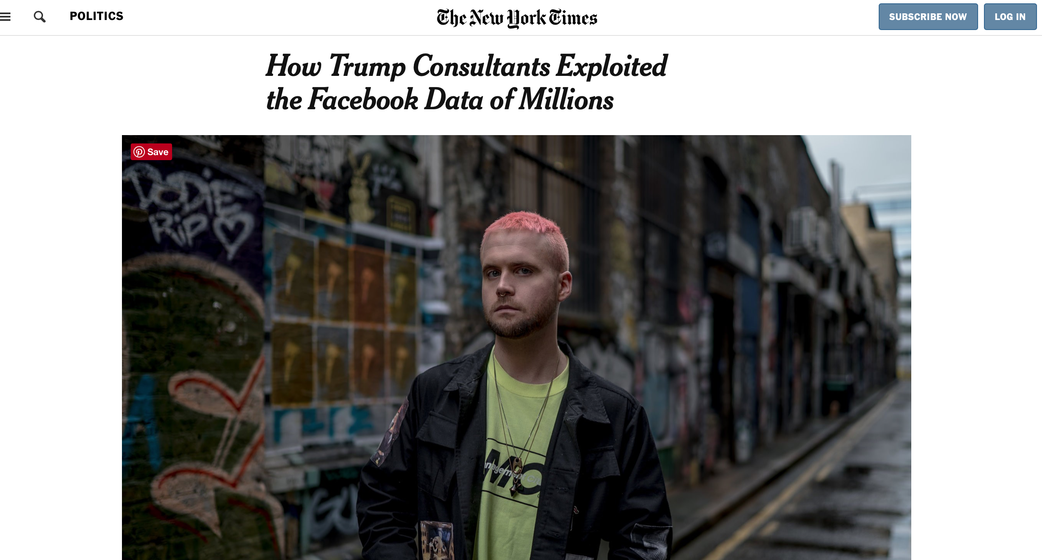
In the news: Cambridge Analytica
Matthew Rosenberg, Nicholas Confessore and Carole Cadwalladr, The New York Times (17 March 2018) https://www.nytimes.com/2018/03/17/us/politics/cambridge-analytica-trump-campaign.html?module=inline

Slide 7

Discuss 3 examples for 10 minutes
with neighbour and report
What are ELSI in data science?

Slide 8
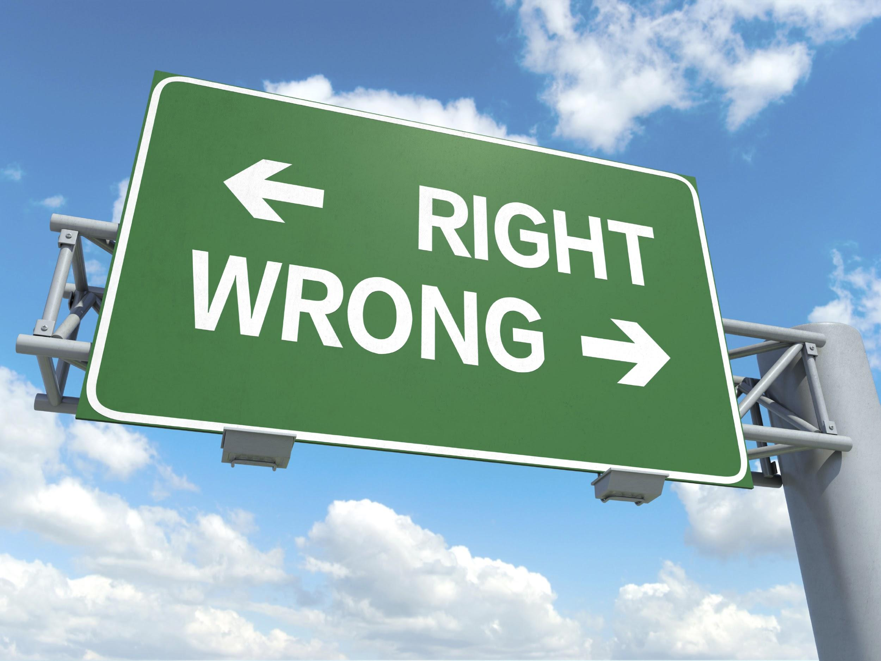
Ethical Issues

Slide 9
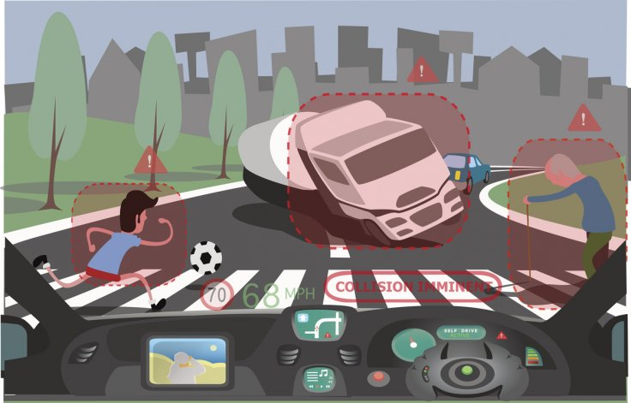
Moral Machines
What should the self-driving car choose?
moralmachine.mit.edu
Oct 8, 2018
Institute of Data Science
Notes:
What bias are we coding into our Knowledge Graph and any systems built on top of the Knowledge Graph?
http://moralmachine.mit.edu/
The biggest example:
autonomous car
There’s no liability on the machine (who’s responsible?)

Slide 10

A knowledge graph as edited information
Findings - The paper concludes that the extension to Google Search, The Knowledge Graph, can serve to radicalize Google's position as a key intermediary of information in users' lives. Rather than simply serving as a gatekeeper supplying the user with an array of links matching a given query, Google now conveniently disseminates information on their own site, roughly rendering the remainder of the web superfluous. Considering both the commercial nature and the opacity of the service, Google as a de facto solo editor of information is worrying from both a democratic and ethical perspective. A culture of emphatic insistence on convenience and consumption is likely to contribute to the impediment of autonomous information retrieval and digital literacy.
Juel Vang, K. (2013). Ethics of Google's Knowledge Graph: some considerations. Journal of Information, Communication and Ethics in Society, 11(4), 245-260.
Notes:
When is editing information ethical?
What could she mean with “democratic” perspective?

Slide 11
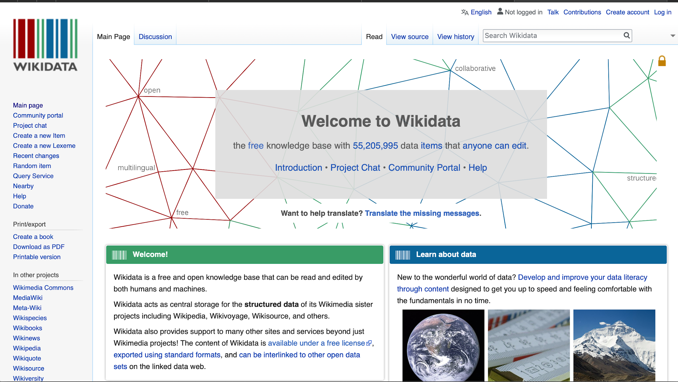
Wikidata
Notes:
Anyone can edit WIKIDATA

Slide 12
Ethical Issues in Individual Projects

Slide 13

Legal Issues

Slide 14
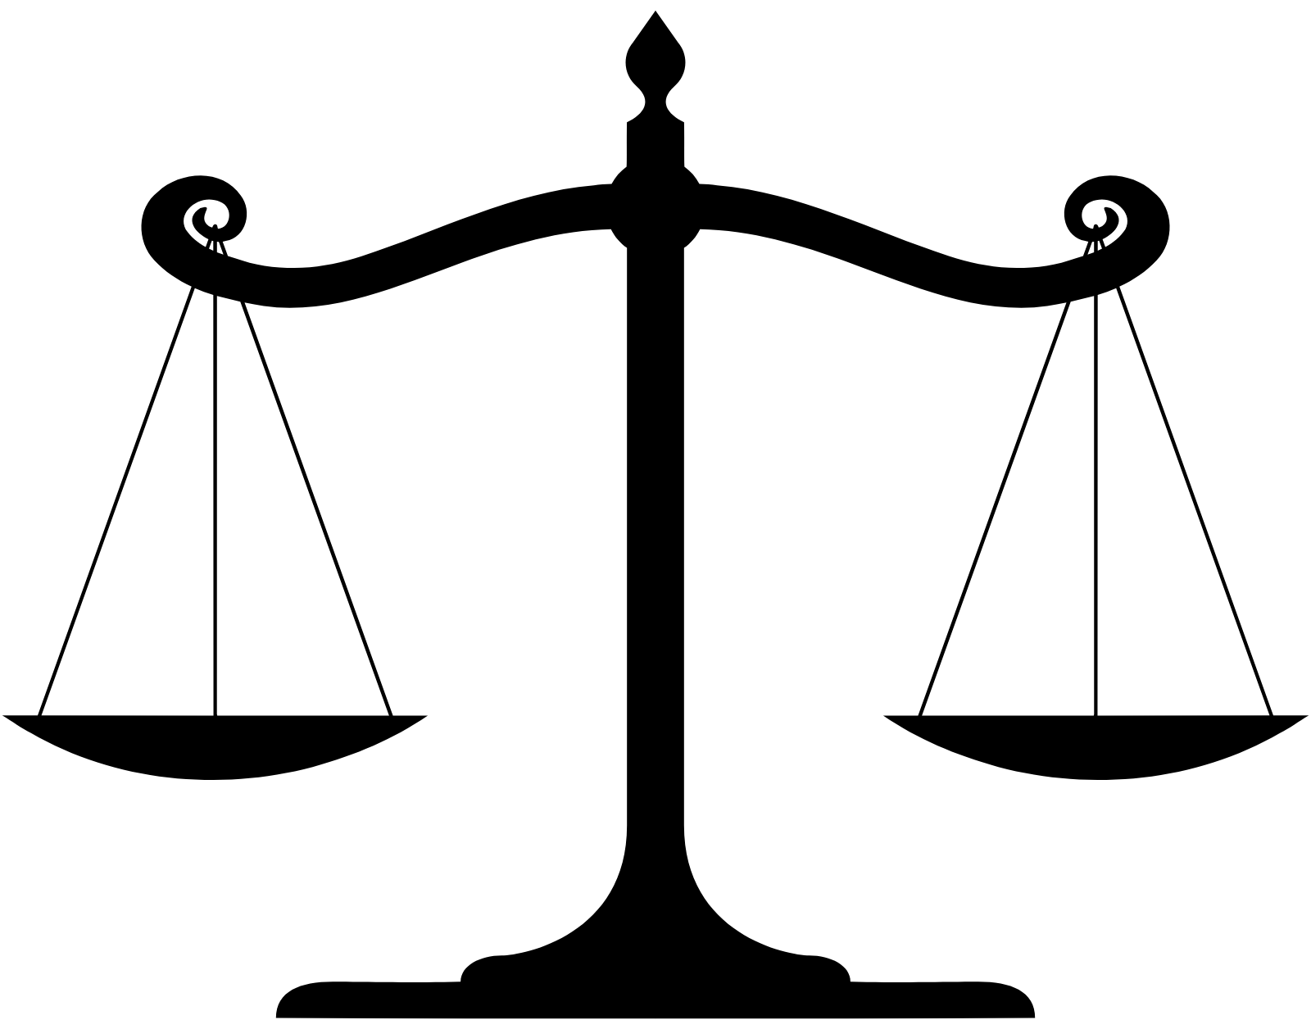
Legal Concerns of Applying Data Science
Social Bias
Data Ethics
AI Liability
Law DS
Data Privacy
Moral Machines
The Future of AI
Oct 8, 2018
Institute of Data Science
Notes:
Data Products
Non ethical examples

Slide 15

General Data Protection Regulation
Regulation for data protection and privacy for all individuals in the EU.
Requires informed consent or legal basis to data processing.
Requires data protection by design and by default by data controllers.
Describes data rights.
Obligation to inform supervisory authority in case of data breaches (and penalties).
Notes:
Major legal framework for data processing of EU individuals data.

Slide 16
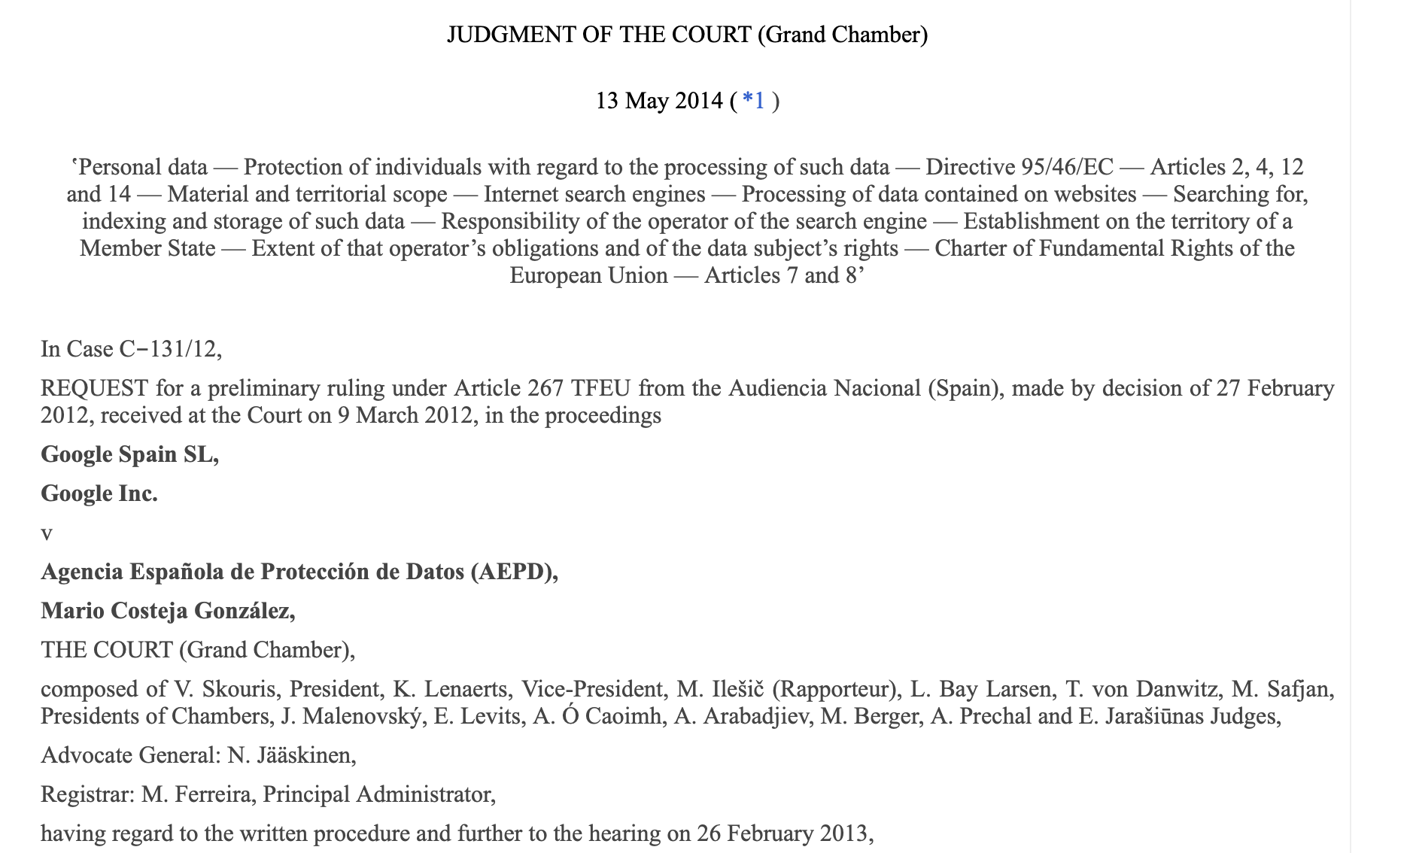

Slide 17
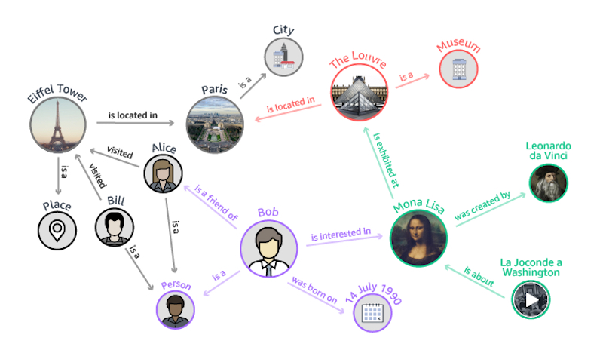
Notes:
Identify personal data that might raise legal issues
---circle

Slide 18
Legal Issues in Individual Projects

Slide 19

Social Issues

Slide 20
Social Bias
Open Google Translate
Input in English “She is a professor. He is a nanny”
Translate to Turkish
Translate back to English
What do we find?
Notes:
Meetup.com use recommendation system to recommend different meetup events to their member based on members interests. The funny thing they found is the algorithm recommend much more tech meetup to male than to female. What they do not wanna see is algo change the industry, more men involve in tech, less and less female participate tech event cuz they do not get the chance to be recommended by algorithms.

Slide 21
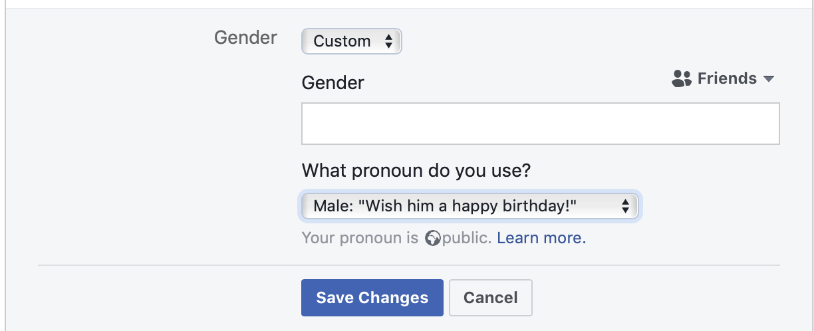
Example: labelling

Slide 22
context:
when is the relation valid?
how did it come into existence?
who or what was involved?
statement provenance:
when was the statement made?
who made the statement?
how was it made?
where was it reported?
what are the terms of use?
Notes:
Think again about these questions from data quality lecture: what is their relation to the ethical, legal and social issues?

Slide 23
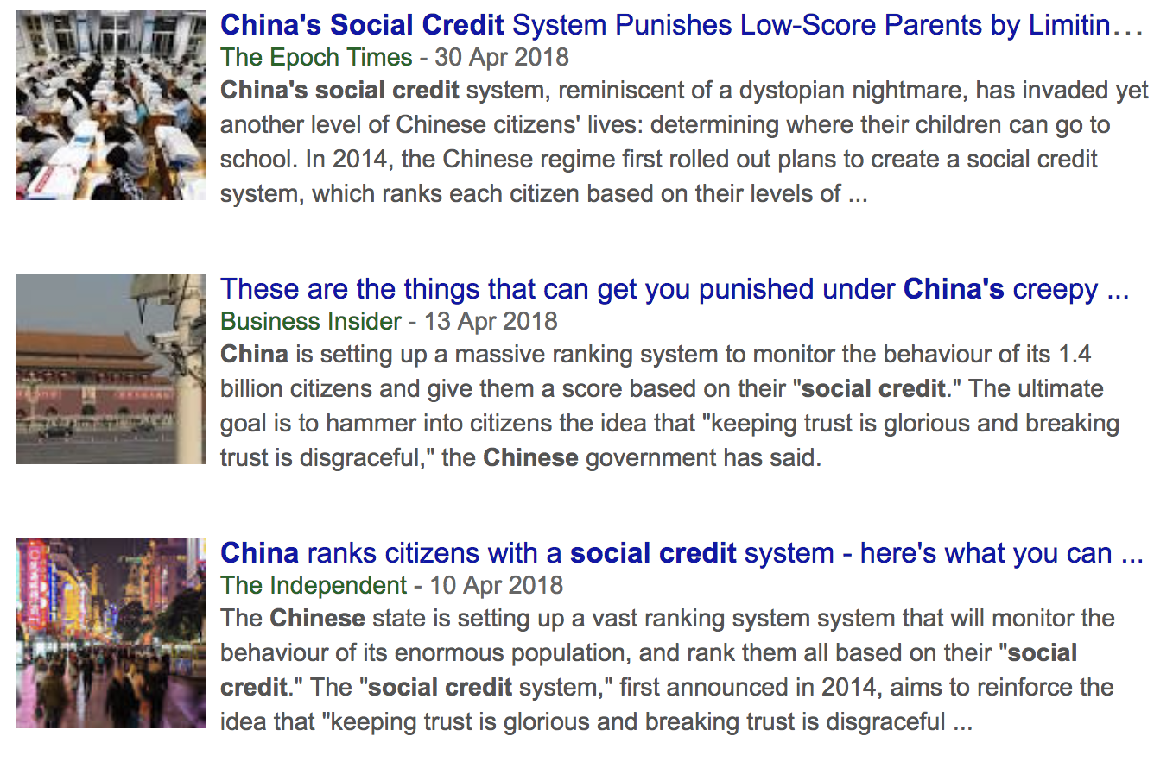
Which Society do you want to live in?
Social credit
Notes:
https://www.voachinese.com/a/news-social-credit-system-puts-people-in-china-under-pressure-20180306/4282752.html

Slide 24


Which Society do you want to live in?
Oct 8, 2018
Institute of Data Science
Notes:
Raises questions for policy makers
New jobs

Slide 25


Social impact

Slide 26
Social Issues in Individual Projects

Slide 27
Summary
Data science projects, including knowledge graphs, may raise ethical, legal and social issues (ELSI)
ELSI may be dealt with by design
Think about what ELSI may be relevant to your individual project
“Just because you can, does not mean you should”

